Slide 1

Believe the future has arrived!
www.jdnevins.com

Slide 2
ABOUT US
Our Story
We are a family owned and operated business founded in 2017. Our service origins however date back to 2002 with the launch of our parent companies (SOHO_SME & SOHOSTME), a digital service and distributed network hosting provider (in other words, a cloud hosting service before people called them 'clouds'). Many of the tools and solutions we used back then are still active and continue to be upgraded.
Our Approach
Our approach could be described as "no-nonsense". We believe in open and transparent dialogue, identifying challenges or issues directly and honestly rather than sugar coating or avoiding them. We value relationships and personalized service and genuinely enjoy helping our clients. We strive to produce clean designs, with clear and concise messaging. And we believe that work can be fun!

Slide 3

ABOUT US
Our Founder
Julian Smit has a BSc. in Psychology from UofT and a degree in sound design and studio engineering. He has over 20 years of experience in the field of Digital Marketing.
He has managed over a dozen award winning digital media projects on behalf of blue-chip organizations such as Manulife and AllState.
He is the host of a Podcast/YouTube Channel - BIYF MARKETING which attracted over 190K views and 3800 subscribers in its first year.
He was the keynote speaker at the 2019 Global Digital Marketing Summit in Jamaica.

Slide 4

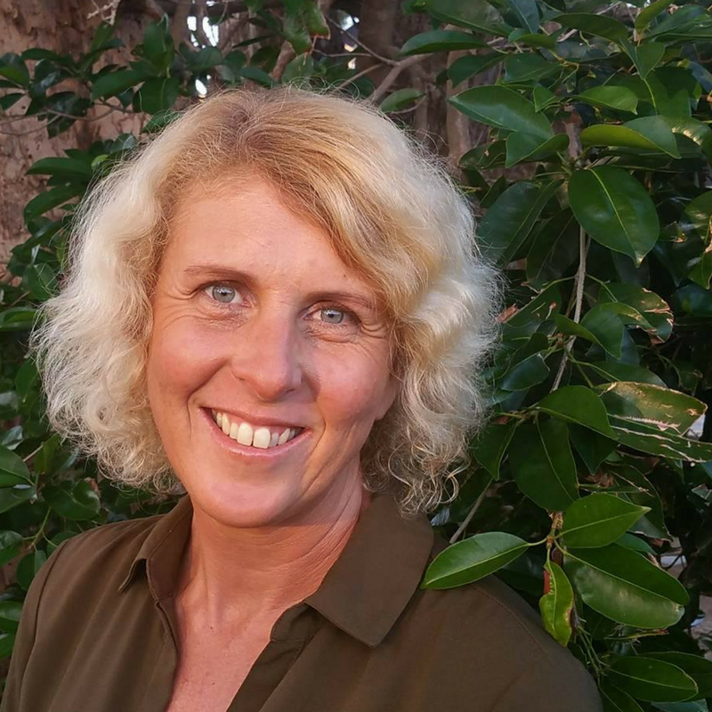



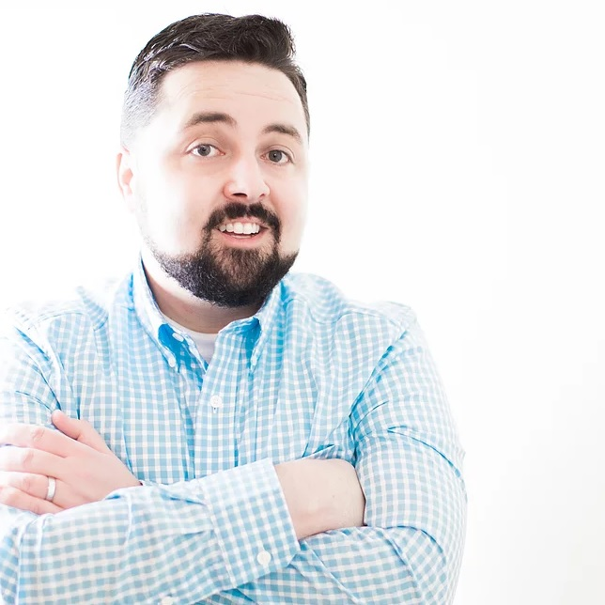

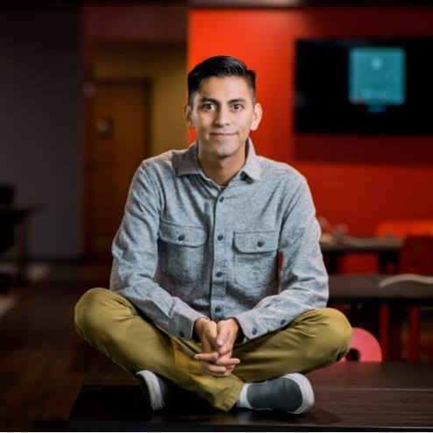
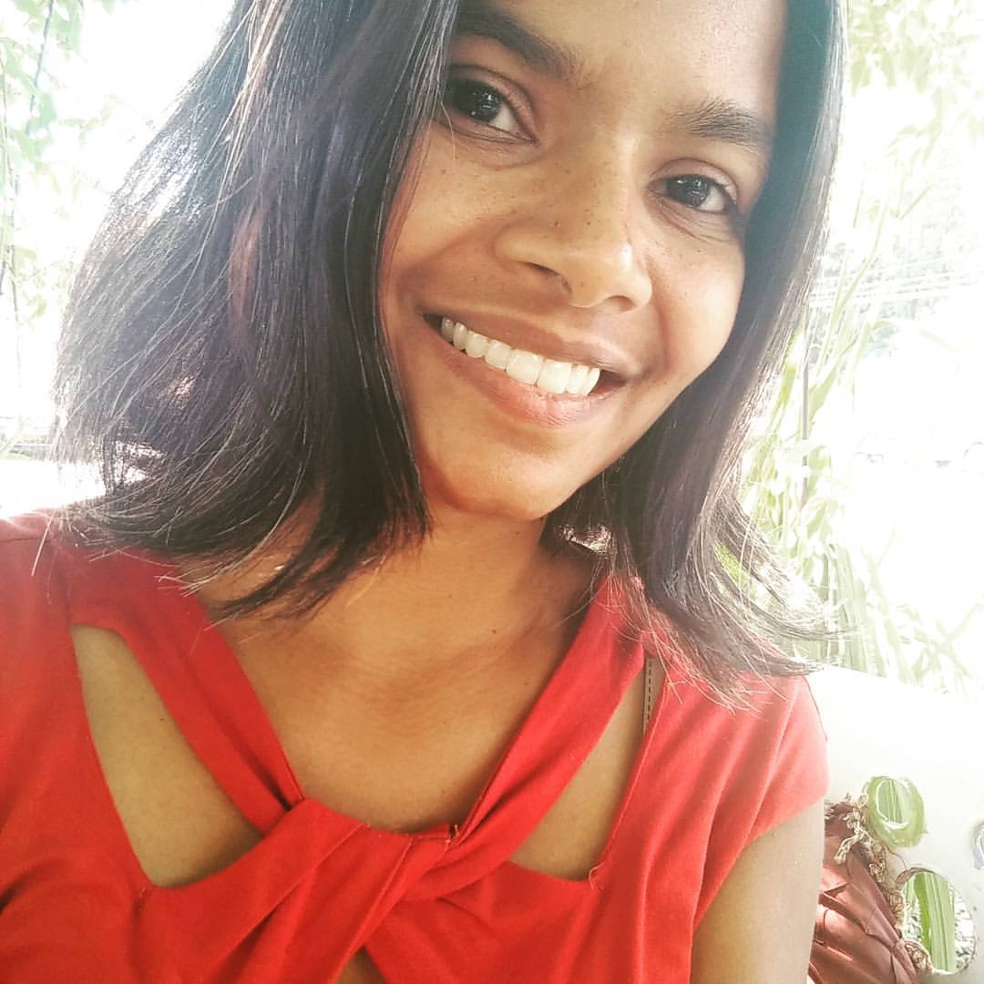

MEET THE MASTERMINDS
Alex Afterman
e-Com & Facebook
Jo McKee
Copywriter
John Max Bolling
Strategy
Casie Lane Millhouse
Creative / Media
Helen Even Chen
Brand Strategy
Stan Way
Sales
Courtney Brophy
Strategy / Facebook
Brandon Smits
Strategy / LinkedIn
Jula Pereira
Project Management
Rutger Thol
Chatbots

Slide 5















360 degrees of digital marketing
Strategy
& Content
Websites:
Design & Build
Multimedia
Production
SEO
Hosting &
Development
Social Marketing
www.jdnevins.ca

Slide 6
WEBSITE DEVELOPMENT
e-Commerce Websites
Sell online simply with our easy and customized web stores. We help you setup your store, import your products and integrate payment gateways so that you are ready to sell within no time. From physical products to digital downloads to subscription plans, you have the flexibility to choose your reach, and we are there to help you focus on your business.
Professional Websites
Our customized websites are designed to focus on YOU. Standing out in a crowd and buzzing online is no easy feat. Each website is executed with careful research and planning before we put together the pixels. We understand the unique needs of each customer and plan out the best responsive site for you.
Portfolio Websites
We understand your website is your brand identify. Bring out your personality with a Feature Rich Portfolio Website. Showcase your Best work and easily win more work with a beautiful responsive website.
Business Websites
With Business having varied needs and marketing objectives, and there is no one size, fits all approach. That is why; we are trusted across the industry for our cutting edge and dynamic web development services. From a small-scale business to scaling up to with fully functional plugins to support varying requirements. We take care of it all.
www.jdnevins.ca

Slide 7


SEARCH ENGINE OPTIMIZATION (SEO)
ON Page SEO
Some strategies in SEO are ever-changing while others remain constant. One of those constants is the importance of keywords found on your site. The success of your website rests on the foundation upon which it’s built.
Organic SEO
Links from High Authority Sources are the most important ranking signal that search engines use to determine your website relevance and influence. Quality trumps quantity, but quantity remains important.
Local SEO
Take control of your local listings and watch your loca-traffic rankings soar with our high-quality, low-cost local SEO management plans. We anticipate this to be a huge growth service for us in 2019-2020.
Maps Pack SEO
Local Business Listings are powerful ranking tools for any local business. But Not All Business Listings are created equal. Helping people find you is only part of an effective strategy. Enticing them at the right time and place is just one of many emerging trends we are excited to offer,
www.jdnevins.ca

Slide 8
PAID ADVERTISING & LEAD GENERARTION
AdWords Campaign Setup
Paid Advertising put you in front of your potential clients at the moment they are looking out for you. Paid advertising, unlike SEO starts producing almost immediate results allowing you to analyse and tweak your campaigns for better performance.
Landing Page Setup
For a high Conversion rate, landing pages with exceptional User Interface (UI) and User Experience (UX) are a must. Additionally, you need well placed Call to Actions. Our team of experienced designers ensure your copy is best-in-class.
Facebook Lead Generation
With a daily active user base of 1.13 billion, Facebook is an ideal platform to reach new audiences you may not have been able to reach otherwise. Facebook has advanced segmentation filters for us to choose our target audience with precision. With the use of advanced tools like chatbots and messenger marketing we help your customers get highly engaged leads for their business.
LinkedIn Lead Generation
LinkedIn is an ideal platform for B2B Lead generation. More that 80% of B2B Social Leads come from LinkedIn. We can help your customers get highly targeted B2B leads in any niche using highly effective LinkedIn Direct Messaging. Personalized direct messages are sent to users open to receiving such common communication.
www.jdnevins.ca

Slide 9
CONTENT DEVELOPMENT
Website Content
Your website is the window to your products and services. Without optimized, catchy content, consumers are going to skip over your brand and look to the competition. Get SEO-optimized, market-researched content for your website.
Online Education Design
Online education requires a unique mix of skills and industry knowledge. Like marketing, education has been transformed by technology. We collaborate with real education experts to create dynamic learning experiences for all ages. Whether you’re a business who wants to develop training modules or a museum looking to transition online, we can help!
Infographics
Considering the average attention span is 8 seconds and shrinking, info graphics accomplish the goal of putting your message across with an elite combination of data and pictures. Info graphics help your business get marketing data across the internet in the best possible visual presentation.
Graphic Design, Animations, Stories
A strong visual appeal offers a wide variety of marketing opportunities for your business. Visuals can have mass appeal and often lead to higher retention rates when used effectively. Social Media platforms are frequently very visual, and posts with effective images and motion frequently outperform text-only posts.
www.jdnevins.ca

Slide 10
MULTIMEDIA PRODUCTION
Video Production
We're able to produce any style of video, for any media from online to television broadcast. We can assist you with your post production requirements. For online this may include streamed hosting, player branding, call-to-action programming, social marketing and analytics tracking.
Illustrations and Animations
Animation and illustrations can often be a cost saving alternative to an expensive video production. They can also be very effective for complex service offerings which require a degree of awareness or education marketing.
Augmented Reality & Gamification
We love it when clients want to get creative! Wouldn’t you have enjoy sharing a branded snap-chat filter? How about a game that builds your brand with a little bit of fun and style?
Vlogging and Podcasting
We have developed one of the simplest yet most efficient systems for managing a Vlog, YouTube channel or Podcast. Automations play a big part in ensuring you get to spend more time producing your content and less time posting and managing it.
www.jdnevins.ca

Slide 11
HOSTING & APPLICATION DEVELOPMENT
Virtual Managed Servers / Streaming Media / SOX Compliant
Our hosting infrastructure was established in 2002 and we depend on it ourselves for its robust security, reliability and flexibility. They were unique and ahead of their time in that we started in the hosting business as a distributed network which offers cross compatibility between UNIX, Linux and Windows™ applications. It was cloud hosting before we knew to call it that.
PHP Application Development
Our PHP software development team has substantial experience of delivering highly secured, multi-user, robust, and high-performance web applications. We create cost-effective business solutions in a creative manner that allows companies to achieve their end-goals efficiently. The implementation of the latest PHP frameworks helps deliver the maximum ROI that reduces the overall development cost.
Mobile Android and IOS Hybrid App Development
From concept to development, J.D. Nevins covers the entire app development cycle, no matter how diverse or complex your needs are. Our ability to meet your needs stem from our team of experts, who have years of experience in global app solution services and product engineering industries. We can develop native and cross-platform mobile apps for multiple mobile OS - Android, iPhone and Windows.
www.jdnevins.ca

Slide 12












SOME AWESOME CLIENTS

Slide 13
Believe the future has arrived!
info@jdnevins.com
www.jdnevins.com

